Slide 1
Cryptography (2022 Fall) IND-CPA, IND-m-CPA, arbitrary length encryption
LiangFeng Zhang
zhanglf@shanghaitech.edu.cn
SIST, ShanghaiTech

Slide 2












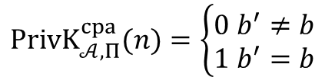
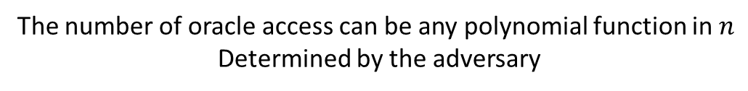
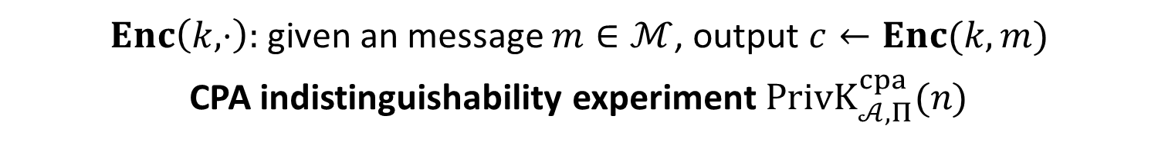


$$\text{Chosen}\text{−}\text{Plaintext} \text{Attack}$$
$Enc\left(k,⋅\right):$given an message $m∈ℳ$, output $c←Enc(k,m)$
CPA indistinguishability experiment $PrivK_{𝒜, Π}^{cpa}(n)$
$$k←Gen\left(1^{n}\right)$$
$$oracle access to$$
$$Enc\left(k,⋅\right)$$
$$m_{0},m_{1}$$
$$\left|m_{0}\right|=|m_{1}|$$
$$Challenger$$
$$b←\{0,1\}$$
$$Adversary 𝒜$$
$$c←Enc(k,m_{b})$$
$$c$$
$$oracle access to$$
$$Enc\left(k,⋅\right)$$
$$b′$$
$$PrivK_{𝒜, Π}^{cpa}(n)=\left\{\begin{aligned}0 b^{′}≠b \\ 1 b^{′}=b\end{aligned}\right.$$
The number of oracle access can be any polynomial function in $n$
Determined by the adversary

Slide 3
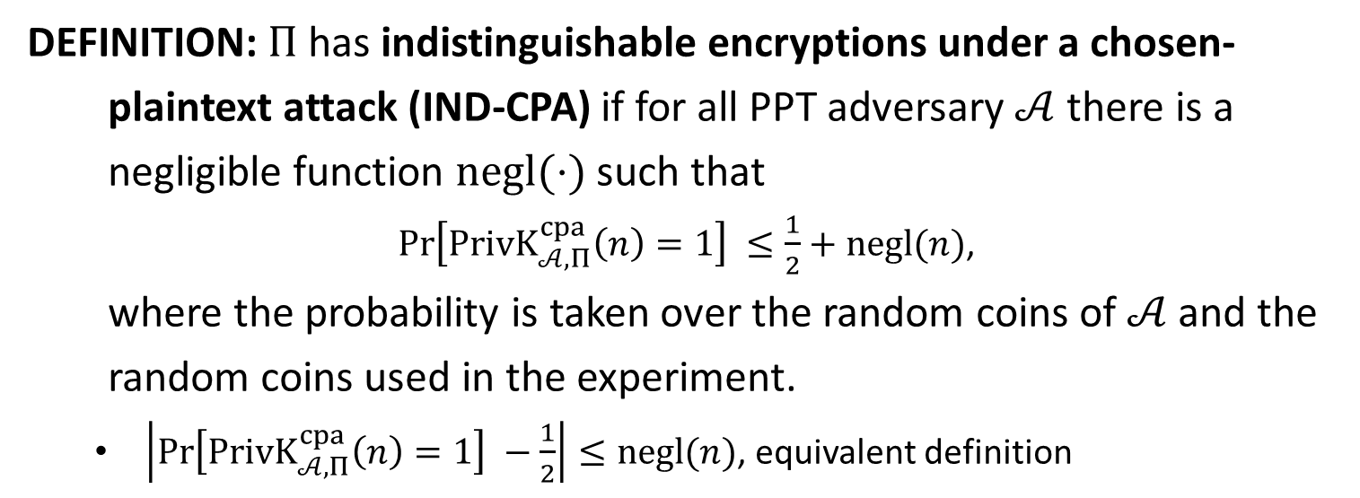
IND-CPA
DEFINITION: $Π$has indistinguishable encryptions under a chosen-
plaintext attack (IND-CPA) if for all PPT adversary $𝒜$ there is a
negligible function $negl(⋅)$ such that
$\operatorname{Pr}\left[PrivK_{𝒜, Π}^{cpa}\left(n\right)=1\right] ≤\frac{1}{2}+negl(n)$,
where the probability is taken over the random coins of $𝒜$ and the
random coins used in the experiment.
$\left|\operatorname{Pr}\left[PrivK_{𝒜, Π}^{cpa}\left(n\right)=1\right] −\frac{1}{2}\right|≤negl(n)$, equivalent definition

Slide 4


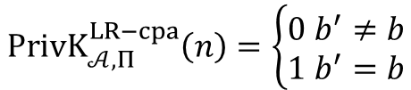
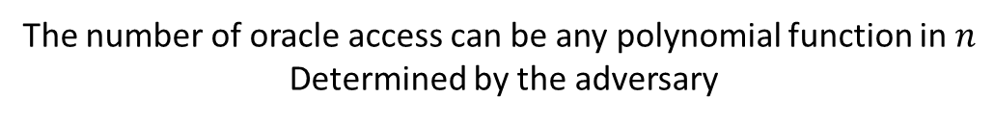






IND-m-CPA
$LR_{k,b}\left(⋅\right):$given $m_{0},m_{1}∈ℳ$, output $c←Enc(k,m_{b})$
LR-Oracle experiment $PrivK_{𝒜, Π}^{LR−cpa}(n)$
$$k←Gen\left(1^{n}\right)$$
$$b←\{0,1\}$$
$$oracle access to$$
$$LR_{k,b}(⋅)$$
$$Challenger$$
$$Adversary 𝒜$$
$$b′$$
$$PrivK_{𝒜, Π}^{LR−cpa}\left(n\right)=\left\{\begin{aligned}0 b^{′}≠b \\ 1 b^{′}=b\end{aligned}\right.$$
The number of oracle access can be any polynomial function in $n$
Determined by the adversary

Slide 5
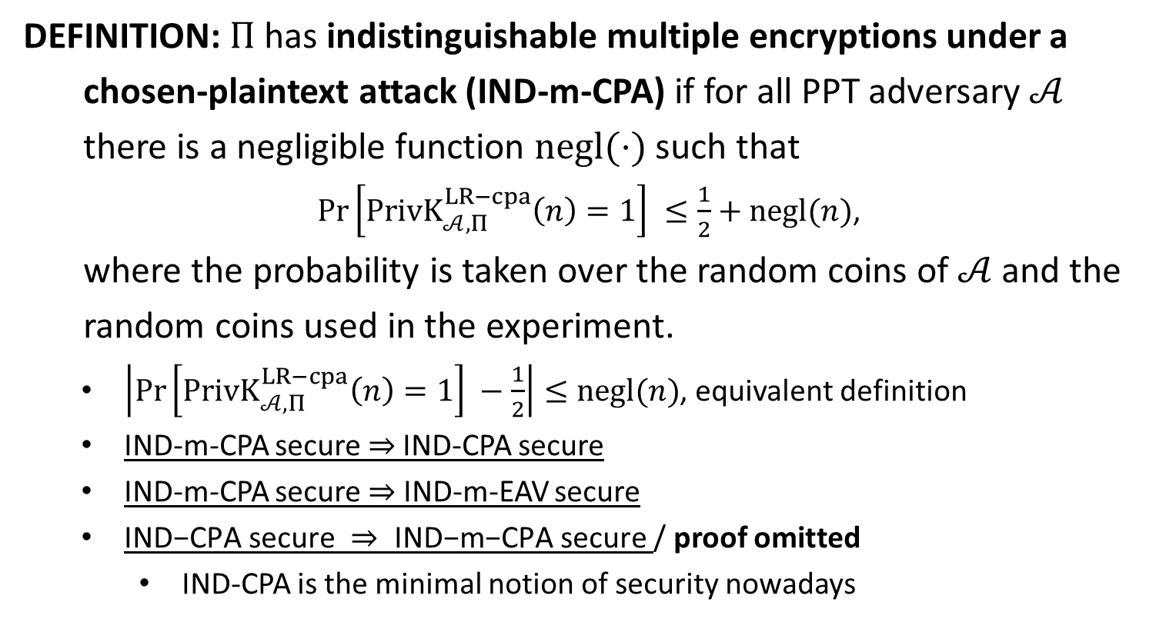
IND-m-CPA
DEFINITION: $Π$has indistinguishable multiple encryptions under a
chosen-plaintext attack (IND-m-CPA) if for all PPT adversary $𝒜$
there is a negligible function $negl(⋅)$ such that
$\operatorname{Pr}\left[PrivK_{𝒜, Π}^{LR−cpa}\left(n\right)=1\right] ≤\frac{1}{2}+negl(n)$,
where the probability is taken over the random coins of $𝒜$ and the
random coins used in the experiment.
$\left|\operatorname{Pr}\left[PrivK_{𝒜, Π}^{LR−cpa}\left(n\right)=1\right] −\frac{1}{2}\right|≤negl(n)$, equivalent definition
IND-m-CPA secure $⇒$IND-CPA secure
IND-m-CPA secure $⇒$ IND-m-EAV secure
$\text{IND}\text{−}\text{CPA} \text{secure} ⇒ \text{IND}\text{−}\text{m}\text{−}\text{CPA} \text{secure}$/ proof omitted
IND-CPA is the minimal notion of security nowadays

Slide 6













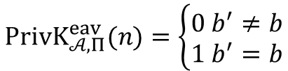




choose $M_{0}=(m_{0,1},…,m_{0,t})$
choose $M_{1}=\left(m_{1,1},…,m_{1,t}\right)$
$\left|m_{0,i}\right|=\left|m_{1,i}\right|, ∀ i$
IND-m-EAV
$$M_{0},M_{1}$$
$$k←Gen\left(1^{n}\right)$$
$$Challenger$$
$$b←\{0,1\}$$
$$Adversary 𝒜$$
$$c_{i}←Enc(k,m_{b,i})$$
$$C=(c_{1},…,c_{t})$$
$$b′$$
$$PrivK_{𝒜, Π}^{eav}(n)=\left\{\begin{aligned}0 b^{′}≠b \\ 1 b^{′}=b\end{aligned}\right.$$
IND-m-CPA
$$k←Gen\left(1^{n}\right)$$
$$b←\{0,1\}$$
$$oracle access to$$
$$LR_{k,b}(⋅)$$
IND-m-CPA is stronger than IND-m-EAV
$$Challenger$$
$$Adversary 𝒜$$
$$b′$$
$$PrivK_{𝒜, Π}^{LR−cpa}\left(n\right)=\left\{\begin{aligned}0 b^{′}≠b \\ 1 b^{′}=b\end{aligned}\right.$$

Slide 7











$$k←Gen\left(1^{n}\right)$$
IND-CPA
$$oracle access to$$
$$Enc\left(k,⋅\right)$$
$$m_{0},m_{1}$$
$$\left|m_{0}\right|=|m_{1}|$$
$$Challenger$$
$$b←\{0,1\}$$
$$Adversary 𝒜$$
$$c←Enc(k,m_{b})$$
$$c$$
$$oracle access to$$
$$Enc\left(k,⋅\right)$$
$$b′$$
$$PrivK_{𝒜, Π}^{cpa}(n)=\left\{\begin{aligned}0 b^{′}≠b \\ 1 b^{′}=b\end{aligned}\right.$$
IND-m-CPA
$$k←Gen\left(1^{n}\right)$$
$$b←\{0,1\}$$
$$orace access to$$
$$LR_{k,b}(⋅)$$
IND-m-CPA is stronger than IND-CPA
$$Challenger$$
$$Adversary 𝒜$$
$$b′$$
$$PrivK_{𝒜, Π}^{LR−cpa}\left(n\right)=\left\{\begin{aligned}0 b^{′}≠b \\ 1 b^{′}=b\end{aligned}\right.$$

Slide 9
Security Definitions
Perfect Secrecy
Perfect Indistinguishability
IND-EAV
IND-m-EAV
IND-CPA
IND-m-CPA

Slide 10
From Fixed-Length to Arbitrary-Length
CONSTRUCTION: $Π′=\left(Gen^{′}, Enc^{′}, Dec^{′}\right)+ℳ′$
Building Block: $Π=\left(Gen, Enc, Dec\right)+ℳ$ is IND-CPA secure.
$Gen^{′}\left(1^{n}\right):$ output $k←Gen(1^{n})$
$Enc^{′}\left(k,m\right):m=m_{1}m_{2}⋯m_{t}∈ℳ^{t}$
$c_{i}=Enc(k,m_{i})$ for every $i∈[t]$
output $c=c_{1}c_{2}⋯c_{t}$
$Dec^{′}(k,c)$
$m_{i}=Dec(k,c_{i})$
output $m=m_{1}m_{2}⋯m_{t}$
THEOREM: If $Π$ is IND-CPA secure, then $Π^{′}$ is also IND-CPA secure.
If $Π$ is IND-m-CPA secure, then $Π^{′}$ is also IND-m-CPA secure

Slide 11














From Fixed-Length to Arbitrary-Length
$$k←Gen\left(1^{n}\right)$$
$$b←\{0,1\}$$
$$orace access to$$
$$orace access to$$
$LR_{k,b}(⋅)$ in $Π′$
$LR_{k,b}(⋅)$ in $Π$
$$b′$$
$$b′$$
$$output 1 iff b^{′}=b$$
$$Challenger$$
IND-m-CPA $Π$
$$ℬ$$
IND-m-CPA $Π′$
$$𝒜$$
$$\operatorname{Pr}\left[PrivK_{ℬ, Π}^{LR−cpa}\left(n\right)=1\right] =\operatorname{Pr}\left[PrivK_{𝒜\text{,}Π^{′}}^{LR−cpa}\left(n\right)=1\right]$$

